Slide 1
Student Performance Prediction Using Multistage Learning
(tentative)
ZHAO Yuqing, SHEN Jiaxing
csyzhao1@comp.polyu.edu.hk

Slide 2
Highlight (148 words)
Student performance prediction helps improve education excellence and reduce the waste of funds caused by unnecessary expenses. Existing methods ignore that education systems inherit multistage systems' characteristics and fail to use the interstage relation. A few articles have observed the sequential nature among stages, but naively rely on the previous stages. Efficient use of interstage relationships can bring additional features to the model and can even solve the data partial unavailability problem. Specifically, given students' academic performance in several semesters and other behavior-related data, our study can utilize the correlation between students' performance between successive semesters. First, our proposed model captures different types of inter-semester relationships. Based on the assumption that "students with similar behaviors perform similarly," we then establish a social learning network of students in successive semesters by mapping students with similar behaviors, thereby predicting new students' GPA and solving the cold start problem.

Slide 3
Outline
Background and motivation
Problem formulation
Existing work
Our approach
Challenge
Possible solution
Notes:
The outline of this presentation is followed by this.

Slide 4



Background and Motivation
Student performance prediction is crucial for education systems.
It helps carry out necessary pedagogical interventions effectively.
It allows instructors to allocate resources and instruction more accurately.
It can ensure students' on-time graduation.

Slide 5
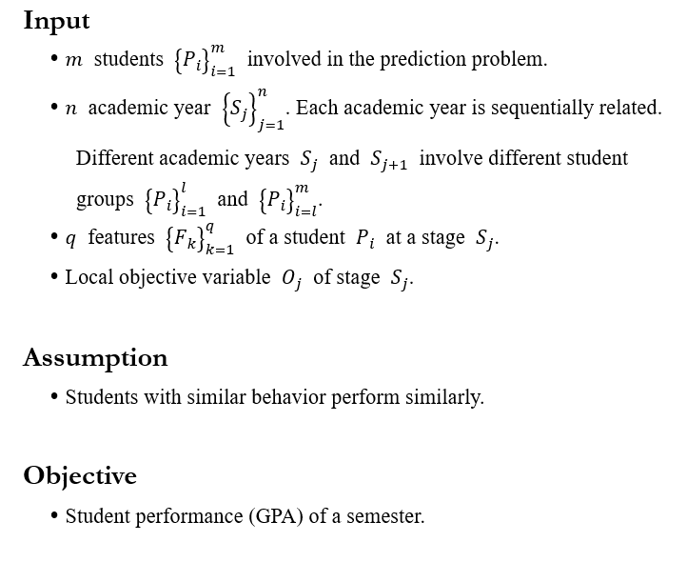
Problem formulation

Slide 6
Existing work
Fail to address the gradient of feature dimension of students
Students in successive grades have gradient feature dimensions, resulting in the diversity in precision.
Past research has simply reduced it to the Cold Start problem of predicting new students. Studies in USTC[1] and Miami University[2] have shown varying accuracy in predicting students in different grades, meaning that their models are not applicable across all samples.
Ignore the stages nature of the education system and fail to make full use of the interstage relations
All the semesters are related through different relation types (feed-back, feed-forward, conditional dependency).
Previous studies only rely on the feed-forward properties. Researches like Knowledge Tracing Models[3] and Time Relational Factorization Models[4] considered the sequential nature of students‘ learning process, but simply abstracted it as Markov process.
[1] Su, Yu, et al. "Exercise-enhanced sequential modeling for student performance prediction." Proceedings of the AAAI Conference on Artificial Intelligence. Vol. 32. No. 1. 2018.
[2] Xu, Jie, et al. "Progressive prediction of student performance in college programs." Proceedings of the AAAI Conference on Artificial Intelligence. Vol. 31. No. 1. 2017.
[3] Piech, Chris, et al. "Deep knowledge tracing." arXiv preprint arXiv:1506.05908 (2015).
[4] Thai-Nghe, Nguyen, Tomáš Horváth, and Lars Schmidt-Thieme. "Factorization models for forecasting student performance." Educational Data Mining 2011. 2010.

Slide 7
Our approach: multistage learning
Abstracted the education system as a multistage system.
The learning process in the education system is staged and connected.
Definition of a stage: one academic year
A stage here refers to a fixed period of time.
A stage is naturally dividable with physical meanings.
Interstage structure: sequential
The interstage structure of a multistage system can be sequential, parallel and hybrid.
Relation types: feedback and feed-forward
The interstage relation type of a multistage system could be feed-forward, feedback, correlation and conditional dependency with hidden causal relationships.

Slide 8
Challenge
The dependency between stages in the education system is complex (conditional and dynamic) and is difficult to define and exploit.
The beginning of a new academic year makes first-year students become second-year students. The dependency at this stage changes.
The feature dimensions of students in each semesters are gradient distributed and dynamic, so it is difficult to construct a unified model.
When first-year students entered their second year, their feature dimensions were twice as the feature dimensions in their first year.

Slide 9
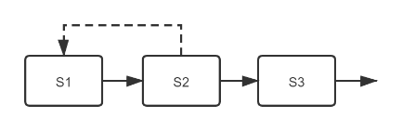
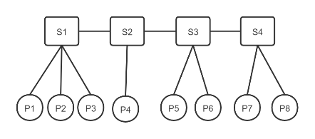




Possible solution
The feedback attribute between stages in Multistage Learning is introduced.
Information from the future stages also has an impact on the current stage.
In the education system, the behavior data of senior students can be used to predict the performance of junior students.
Use student-stage attribute network to represent the interstage relation between students.

